Slide 1
Liferay
Octubre 2015
Notes:
To change the logo in the footer, go to the VIEW menu > Master > Slide Master, and replace the existing logo by your entity's logo.
To edit the confidentiality level, go to the INSERT menu > Header and footer, and fill in the desired level.

Slide 2
Liferay como líder en portales por sexto año consecutivo.
Gartner
Notes:
The background color can be changed using the color commands of the slide background (preferably selecting from among the colors of the predefined palette).
(right click on the slide’s background + “Format background”).

Slide 3
TEMARIO
Entendiendo Liferay
Conceptos básicos (Instancia, Sitio/Organización, Página, Portlet)
Gestor de contenido (Estructura/Plantilla)
Administrador de Documentos
Notes:
Page numbers are flushed right using the tab function ("->” key or "TAB" key), and are formatted manually (Century 12 pt., dark blue).
Chapters are numbered automatically.
To edit the footer for the entire document, go to INSERT > Header and footer, and fill in the desired titles and dates.
The vertical line should be adjusted manually.

Slide 4
Entendiendo Liferay
Introducción
Notes:
The background color can be changed using the slide’s background color commands (preferably using the color palette). Note that we recommend using either this color or that of the following slide (10th color of the predefined palette).
(right click on the slide + “Format background”). Here, the 4th color of the predefined palette was chosen.

Slide 5
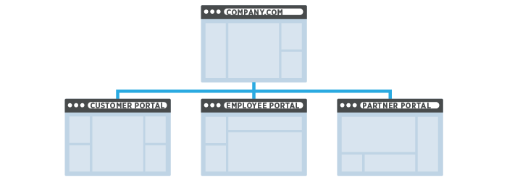
ENTENDIDENO LIFERAY
¿Qué es Liferay?
Liferay como Gestor de Contenidos
Administrador de páginas.
Administrador de contenido web.
Administrador de documentos y multimedia.
Compatibilidad con diferentes idiomas.
Liferay como Plataforma Desarrollo
Creación de portlets.
Java,MVC,JSP,JSF,Velocity,XML, etc.
Creación de temas de apariencia (responsive).
Liferay como Portalizador
Administrador multiples entornos lógicos (instancias).
Administrador de multiples sitios/portales.
Notes:
To change bullet colors, select the text in question and go to the HOME menu > Bullets and numbers, choose "Custom bullet" and choose the desired bullet.
To insert the bullets to the PowerPoint bullet library, go to menu > Bullets and numbers, choose “bullets and numbering”, choose “picture”, choose import”, select the bullets’ folder previously saved on the hard drive and validate.

Slide 6
Conceptos básicos Liferay
Instancia, Sitio/Organización, Página, Portlet
Notes:
The background color can be changed using the slide’s background color commands (preferably using the color palette). Note that we recommend using either this color or that of the following slide (10th color of the predefined palette).
(right click on the slide + “Format background”). Here, the 4th color of the predefined palette was chosen.

Slide 7
CONCEPTOS BÁSICOS
RECURSOS
Instancia
Sitio /
Organización
Página
Réplica de todas las funcionalidades de Liferay.
Múltiples e independientes.
Solo se configura un dominio.
Ej. axa.mx/distribuidores.axa.com.mx
Un grupo de páginas organizadas de manera jerárquica.
Contenido web (HTML) y contenido multimedia.
Espacio dentro del portal que permite visualizar contenido HTML y/o multimedia.
Esta conformado por plantillas TPL.
Dentro de las plantillas insertamos portlets.
Públicas/privadas

Slide 8
CONCEPTOS BÁSICOS
PLUGINS
PORTLET
HOOK/EXT
LAYOUT TPL/THEME
Apliación que realiza una tarea específica.
Java Portlet Specification JSR-286.
Java, JSP, JSF, Velocity, XML, XSL, etc.
Plugin para modificar una funcionalidad nativa de los portlets o portal.
Agregar nueva funcionalidad al portal o core.
Plantilla que conforma la estructura.
Esta conformado por Plantillas TPL.
Dentro de las plantillas insertamos portlets.

Slide 9
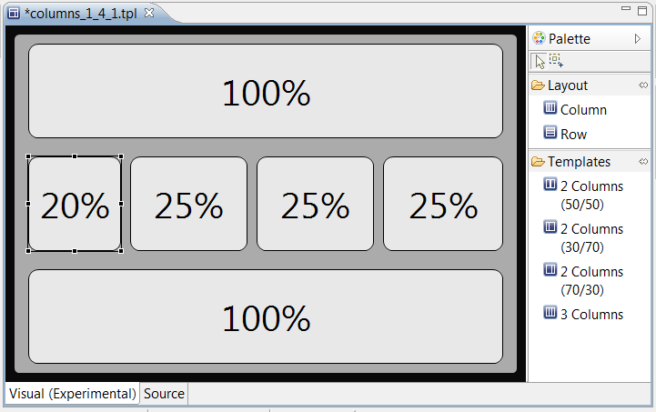
CONCEPTOS BÁSICOS
Notes:
Vector elements can be increased in size without loss of quality.
Bullets are also available as high-definition PNG images that can be integrated in the PowerPoint bullet library (menu for choosing bullets, “bullets and numbering” button “picture” button, “import” button, select the bullets folder previously saved on the hard drive).
RVB values, with the number of the position in the predefined palette, extracted from the AXA guidelines:
Color 3 (grey) = 112/113/115 lightened to 50% = 184/184/185
Color 4 (dark blue) = 0/69/99 lightened to 50% = 128/162/177
Color 5 (medium blue) = 73/119/182 lightened to 50% = 164/187/219
Color 6 (sea green) = 0/114/122 lightened to 50% = 128/185/189
Color 7 (yellow) = 250/206/80 lightened to 50% = 253/231/168
Color 8 (AXA logo red) = 228/10/56 lightened to 50% = 242/133/156
Color 9 (violet) = 85/0/52 lightened to 50% = 170/128/154
Color 10 (dark blue lightened to 50% = 128/162/177

Slide 10
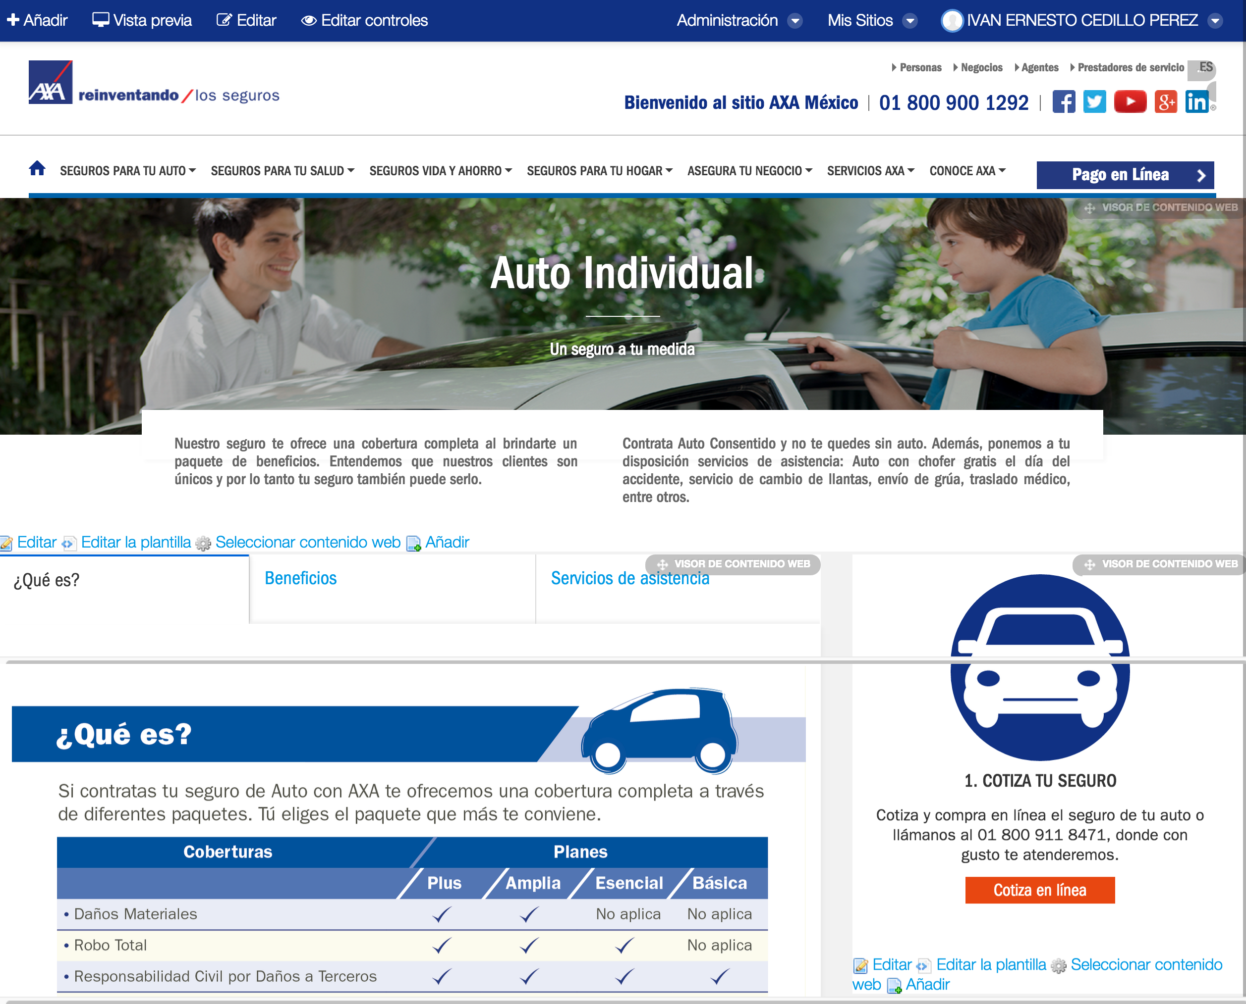
CONCEPTOS BÁSICOS
Notes:
Vector elements can be increased in size without loss of quality.
Bullets are also available as high-definition PNG images that can be integrated in the PowerPoint bullet library (menu for choosing bullets, “bullets and numbering” button “picture” button, “import” button, select the bullets folder previously saved on the hard drive).
RVB values, with the number of the position in the predefined palette, extracted from the AXA guidelines:
Color 3 (grey) = 112/113/115 lightened to 50% = 184/184/185
Color 4 (dark blue) = 0/69/99 lightened to 50% = 128/162/177
Color 5 (medium blue) = 73/119/182 lightened to 50% = 164/187/219
Color 6 (sea green) = 0/114/122 lightened to 50% = 128/185/189
Color 7 (yellow) = 250/206/80 lightened to 50% = 253/231/168
Color 8 (AXA logo red) = 228/10/56 lightened to 50% = 242/133/156
Color 9 (violet) = 85/0/52 lightened to 50% = 170/128/154
Color 10 (dark blue lightened to 50% = 128/162/177

Slide 11
Gestor de contenidos
Contenido web: Estructuras/Plantillas
Notes:
The background color can be changed using the slide’s background color commands (preferably using the color palette). Note that we recommend using either this color or that of the following slide (10th color of the predefined palette).
(right click on the slide + “Format background”). Here, the 4th color of the predefined palette was chosen.

Slide 12
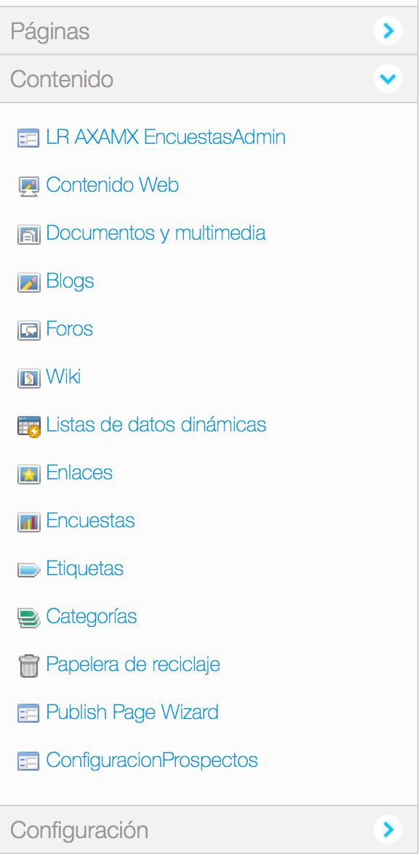
GESTOR DE CONTENIDOS
Contenido Web, Blog, Foros de discusión, Documentos multimedia
Principales recursos:
Contenido web personalizado organizado en carpetas.
Blogs.
Foro de discusión.
Documentos y multimedia.
Contenido web personalizado
Creación de estructras (XML).
Creación de plantillas (velocity).
Visor de contenido web.
Publicador de contenido.
Plantillas de aplicación (ADT).
Notes:
To change bullet colors, select the text in question and go to the HOME menu > Bullets and numbers, choose "Custom bullet" and choose the desired bullet.
To insert the bullets to the PowerPoint bullet library, go to menu > Bullets and numbers, choose “bullets and numbering”, choose “picture”, choose import”, select the bullets’ folder previously saved on the hard drive and validate.

Slide 13
GESTOR DE CONTENIDOS
Contenido Web, Blog, Foros de discusión, Documentos multimedia
Estructuras – Tipo de campos.
Texto y caja de texto.
Boolean, número, decimal y entero.
Enlace, documento multimedia e imagen.
Radio button y combo box.
Fecha y caja de texto HTML.
Plantillas - Ventajas.
Lenguaje Apache Velocity.
Inserción de código HTML, JS, CSS.
Acceso a la API Liferay (LocalServieUtil).
Plantillas de aplicación (ADT).
Notes:
To change bullet colors, select the text in question and go to the HOME menu > Bullets and numbers, choose "Custom bullet" and choose the desired bullet.
To insert the bullets to the PowerPoint bullet library, go to menu > Bullets and numbers, choose “bullets and numbering”, choose “picture”, choose import”, select the bullets’ folder previously saved on the hard drive and validate.

Slide 14
Administrador de documentos
Repositorio multimedia
Notes:
The background color can be changed using the slide’s background color commands (preferably using the color palette). Note that we recommend using either this color or that of the following slide (10th color of the predefined palette).
(right click on the slide + “Format background”). Here, the 4th color of the predefined palette was chosen.

Slide 15
ADMINISTRADOR DE DOCUMENTOS
Repositorio multimedia
Documentos multimedia
Gestión por carpetas.
Tipos de archivo.
PDF, PNG, JPG, DOC, XLS, PPT, MP3, MP4, etc.
Restricción de tamaño y formato por el administrador.
Categorización, etiquetación.
Carga masiva, compatibilidad con navegadores Drag & Drop.
URL única para descarga.
Adignación de permisos de acceso, visualización y descarga.
Aplicación de escritorio Liferay Sync.
Notes:
To change bullet colors, select the text in question and go to the HOME menu > Bullets and numbers, choose "Custom bullet" and choose the desired bullet.
To insert the bullets to the PowerPoint bullet library, go to menu > Bullets and numbers, choose “bullets and numbering”, choose “picture”, choose import”, select the bullets’ folder previously saved on the hard drive and validate.

Slide 16
Gracias
Notes:
La couleur de fond peut être changée avec les commandes de couleur d'arrière-plan de slide (à choisir dans les couleurs de la palette prédéfinie, de préférence)
(clic droit sur le fond de la slide + "Mise en forme de l'arrière-plan").

